Slide 1
The Powerflow Module
This section will introduce you to the distribution powerflow simulator.

Slide 2
Powerflow Overview
Powerflow is the fundamental power system analysis tool.
Given the voltage of the generators and the load on the system it determines voltage at all points on the system.
This in turn defines the currents on the system and indicates if the system is properly loaded.

Slide 3
Powerflow Overview
Transmission Systems
  Powerflow was originally limited to the transmission system.
  Many assumptions were made in the early developments of transmission power flow. e.g. only positive sequence.
Distribution Systems
  Powerflow simulations were not originally performed since stability and voltage sag issues were minimal.
  Was initially based on simple circuit equivalents.
  Sequential components were used, but found to be inappropriate.
  Recent work has focused on more complete modeling.

Slide 4
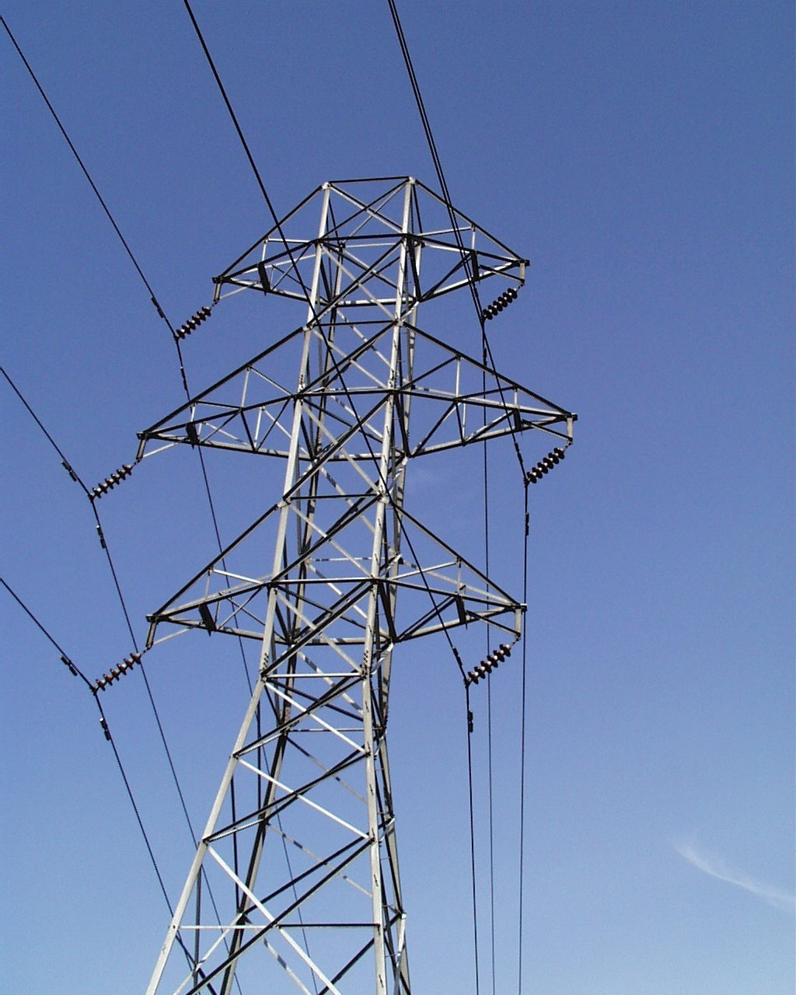
Transmission System

Slide 5
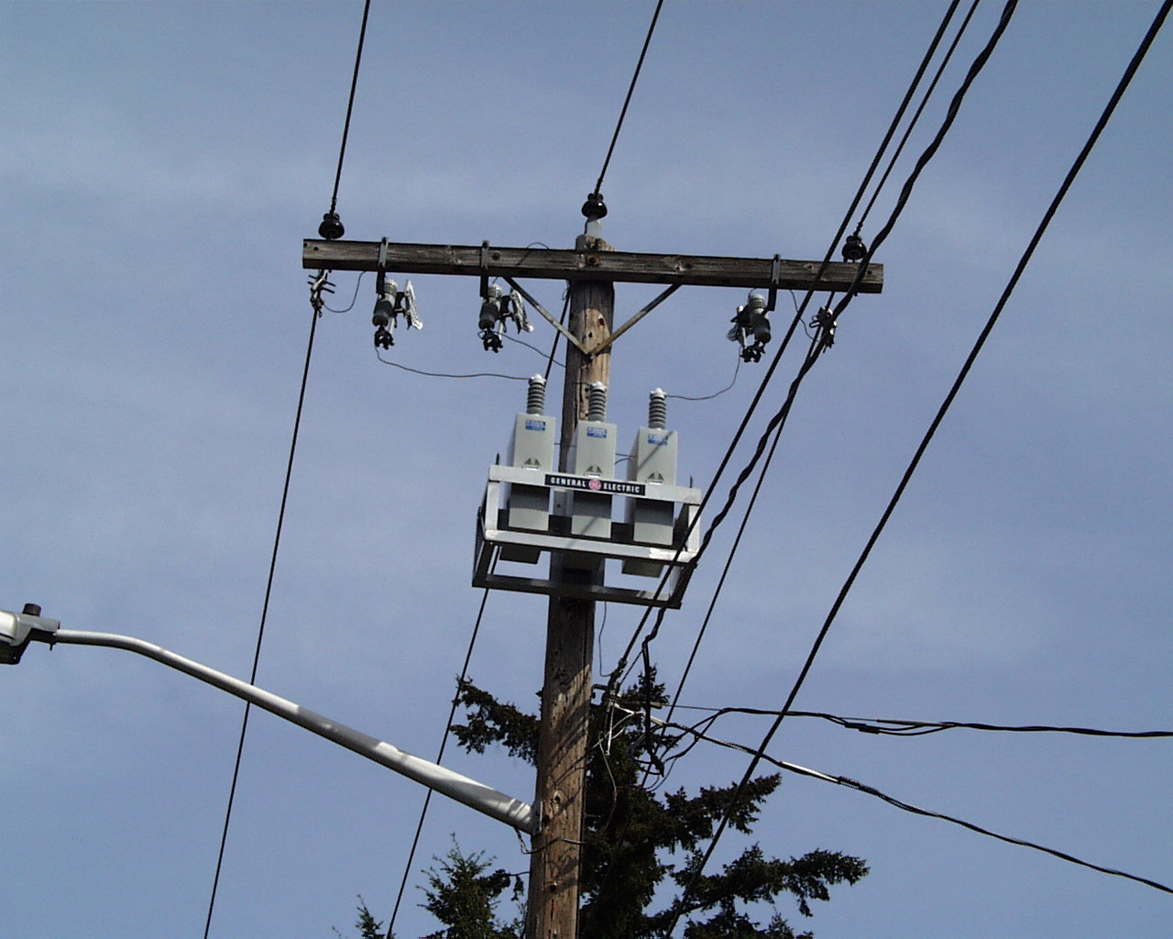
Distribution System

Slide 6
System Representations
Positive Sequence
Three-phase
System is assumed to be three-phase balanced.
Single-phase equivalent models are used.
Each phase, including neutral, is explicitly modeled.
Electromagnetic coupling between phases is included.
This allows for more accurate modeling including:
  Split-phase systems
  Single-phase loads
  Two-phase loads

Slide 7

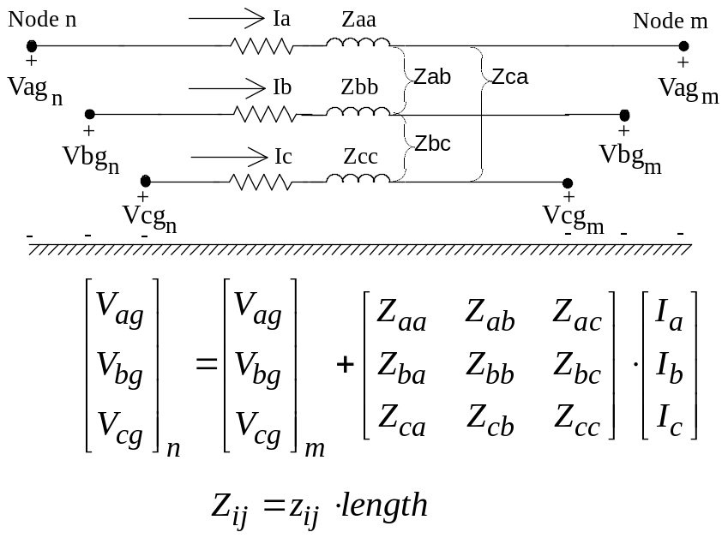



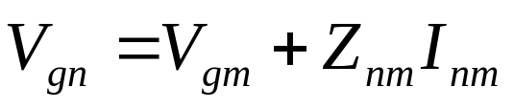
Modeling comparisons
Positive Sequence
Unbalanced
+
-

Slide 8

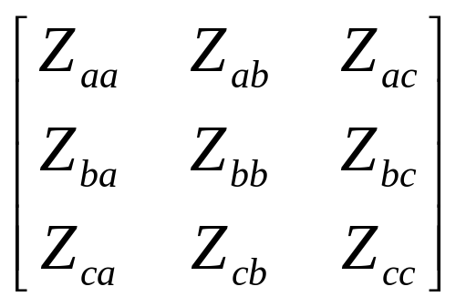
Three-phase Unbalanced
a
2.5'
b
4.5'
c
3.0'
4.0'
n
24.0'
Phase Conductor: 336,400 26/7
GMR = 0.0244 ft., Resistance = 0.306 Ω/mile, Diameter = 0.721 inch
Neutral Conductor: 4/0 6/1 ACSR
GMR = 0.00814 ft., Resistance = 0.592 Ω/mile, Diameter = 0.563 inch
Physical System
Parameterized Values
Values for Numeric Simulation

Slide 9
Powerflow Methods
Transmission Systems
  Direct Current
  Gauss-Seidel
  Newton-Raphson
  Decoupled
Distribution Systems
  Forward Backward Sweep
  Direct Current
  Gauss-Seidel
  Newton-Raphson

Slide 10
Clarification
The power flow component of GridLAB-D is separated into a distribution module and a transmission module.
  The distribution module uses three-phase unbalanced powerflow
  The transmission module uses a Gauss-Seidel approach (no longer supported)
In GridLAB-D, the name of distribution module is “powerflow”; the name of transmission module is “network” (in the process of deprecation).

Slide 11
Three Powerflow Solver Techniques
Forward/Backward Sweep method
  Fast, efficient, and robust
  Cannot solve for meshed systems
Gauss-Seidel method (unsupported)
  Easy to implement
  Applicable to diagonally dominant matrix
  Implicitly parallel
  Converges very slowly
Newton-Raphson Method
  Requires that the derivative be calculated directly
  Converges quickly for good initial values, otherwise, may fail to converge

Slide 12


Backward/Forward Sweep Method
Node n
Node m
Impedance Matrix
[Iabc]_{n}
[Iabc]_{m}
[Vabc]_{n}
[Vabc]_{m}
Backward Sweep
Forward Sweep

Slide 13
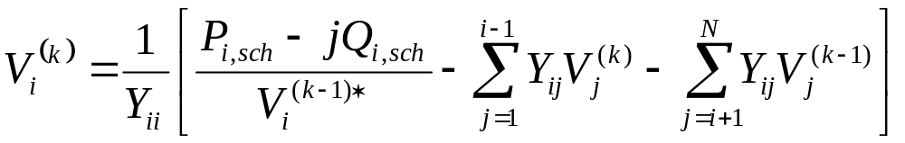
Gauss-Seidel Method
V is the node voltage
i is the current node
k is the current iteration number
Y_{ii} is the self admittance matrix
P_{i,sch} is the scheduled real power injection
Q_{i,sch} is the scheduled reactive power injection
Y_{ij} is the admittance of the link connecting node i with node j

Slide 14
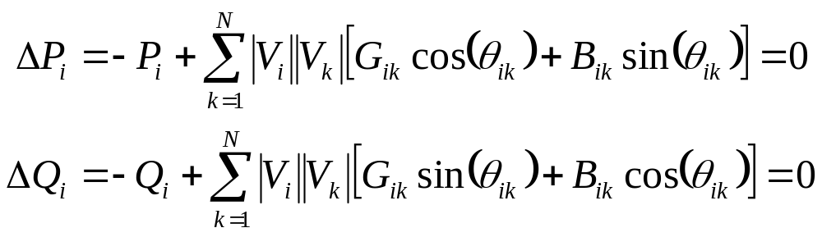
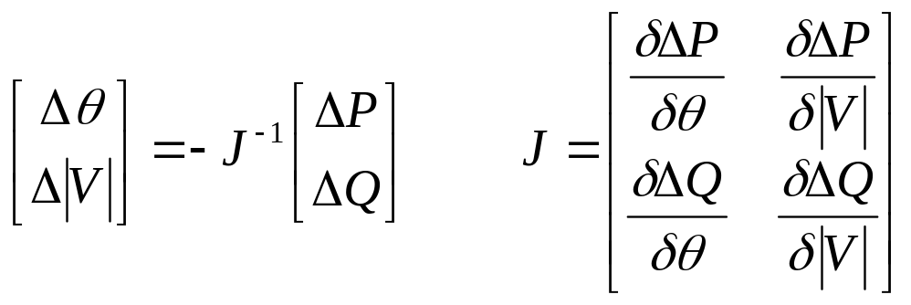
Newton-Raphson Method
P_{i} is the real power injection at node i
Q_{i} is the reactive power injection at node i
G_{ik} is real portion of the admittance between node i and k
B_{ik} is imaginary portion of the admittance between node i and k
V_{i} is the voltage magnitude at node i
δ_{i} is the voltage angle at node i

Slide 15
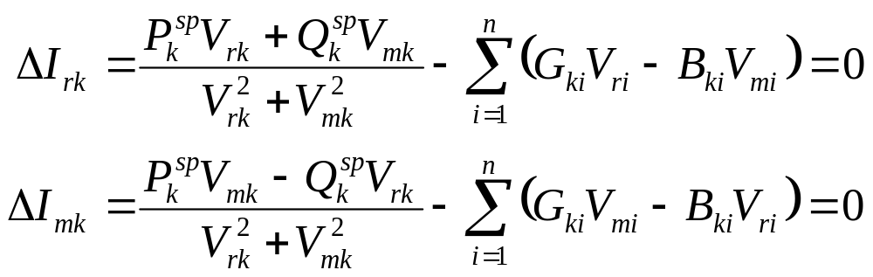
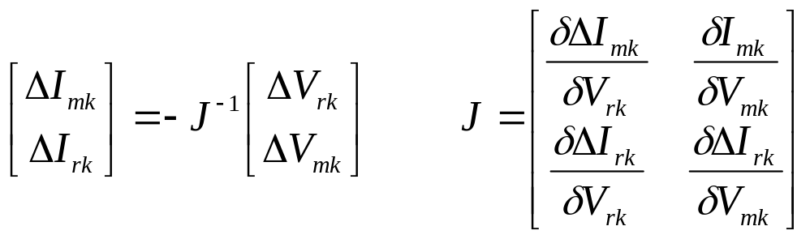
Newton-Raphson Method (TCIM)
P_{k} is the scheduled real power injection at node i
Q_{k} is the scheduled reactive power injection at node i
G_{ik} is real portion of the admittance between node i and k
B_{ik} is imaginary portion of the admittance between node i and k
V_{rk} is the real component of voltage at node k
V_{mk} is the imaginary component of voltage at node k

Slide 16
Powerflow Module
The powerflow module is used to simulate the distribution network.
The powerflow module of GridLAB-D utilizes the forward and backward sweep method (Kersting’s FBS) for solving the power flow problem as the default solver.
Gauss-Seidel method was attempted, but found to be ineffective.
Newton-Raphson solver has been integrated (Penido et. al.’s TCIM) to handle re-configuration scenarios and meshed systems.

Slide 17
How does it work?
The distribution network is handled as a system of nodes and links.
Forward-Backward Sweep (FBS)
  Voltage (nodes) and current (links) are passed along the distribution network in a series of sweeps.
  The sweeps are repeated for each time step until the system converges with zero voltage “error”.
Newton-Raphson (NR)
  Admittance matrix is built with link objects and used to calculate node voltages from given current injections.
  Iterations are performed within SuperLU until voltage “error” converges to zero.
  Iterations are performed within GridLAB-D to handle all control algorithms.

Slide 18
Powerflow module directives
module powerflow {
solver_method FBS; //NR; GS is deprecated
default_maximum_voltage_error 1e-6; //Defines convergence criteria
NR_iteration_limit 50; //No. of SuperLU iterations per GLD iter.
NR_superLU_procs 1; //No. of processors used by SuperLU
}
As implemented, FBS is faster and more robust.
As implemented, NR handles meshed systems and reconfiguration algorithms.
Method to be used depends upon application, but both methods currently work with all objects in powerflow and all other modules.

Slide 19
Objects in Powerflow Module
Two main object types: node and link.
Most objects inherit properties from node and link.
Other objects are used to specify different configurations that may be used multiple times
  line_configuration
  line_spacing
  transformer_configuration
  regulator_configuration

Slide 20
Objects in Powerflow Module
The FBS power flow calculation is done at the level of node objects and link objects.
Node Objects
  Capacitor
  Series Reactor
  Load
  Meter/triplex_meter
  PQLoad
  Billdump
  Voltdump
  Motor (in development)
  Frequency_gen
  Volt_var_control
Link Objects
  Fuse/Switch/Relay
  Overhead_line/Underground_line/triplex_line
  Regulator
  Transformer

Slide 21
Objects in powerflow Module
object node {
complex voltage_A[V]; //Used to initialize voltage solution
complex voltage_B[V]; // then tracks voltage over time
complex voltage_C[V];
complex voltage_AB[V]; //Delta voltage connections
complex voltage_BC[V];
complex voltage_CA[V];
complex current_A[A];
complex current_B[A];
complex current_C[A];
complex power_A[W];
complex power_B[W];
complex power_C[W];
complex shunt_A[S];
complex shunt_B[S];
complex shunt_C[S];
string phases; //A,B,C,D, or S
enum bustype; //PQ (default), PV, SWING
double maximum_voltage_error;
}

Slide 22
Objects in powerflow Module
object load {
/*in addition to inherited properties from node object*/
complex constant_power_A[VA];
complex constant_power_B[VA];
complex constant_power_C[VA];
complex constant_current_A[A];
complex constant_current_B[A];
complex constant_current_C[A];
complex constant_impedance_A[Ohm];
complex constant_impedance_B[Ohm];
complex constant_impedance_C[Ohm];
}
May be used to define load classes (residential/industrial/commercial/agricultural)

Slide 23
Objects in powerflow Module
object meter {
/*in addition to inherited properties from node object*/
double measured_real_energy[Wh];
double measured_reactive_energy[Vah];
complex measured_power[VA]; // Also measured_power_A, _B, _C
double measured_real_power[W];
double measured_reactive_power[W];
complex measured_voltage_A[V];
complex measured_voltage_B[V];
complex measured_voltage_C[V];
complex measured_current_A[A];
complex measured_current_B[A];
complex measured_current_C[A];
}
The meters are the interaction point between the powerflow module and the commercial and generator modules (often used on loads)

Slide 24
Objects in powerflow Module
object triplex_meter {
/*in addition to inherited properties from node object*/
double measured_energy[Wh];
double measured_power[W];
double measured_real_power[W];
double measured_reactive_power[W];
complex measured_voltage_1[V];
complex measured_voltage_2[V];
complex measured_voltage_N[V];
complex measured_current_1[A];
complex measured_current_2[A];
complex measured_current_N[A];
}
The triplex meters are the interaction point between the powerflow module and the residential module.
Billing information may also be extracted using bill_mode.

Slide 25
Objects in powerflow Module
object overhead_line {
/* inherited from link objects */
string name;
string phases; //A,B,C,D, or S
object from;
object to;
/* Specific to line objects */
double length[ft];
object configuration;
}
unlike node objects, there is no “generic” link object
underground_line and triplex_line follow the same format
“to” and “from” define the two nodes that the link connects
configuration is defined by a separate object
configuration and length determine all relevant matrices for powerflow calculations

Slide 26
Objects in powerflow Module
object line_configuration {
object conductor_A;
object conductor_B;
object conductor_C;
object line_spacing;
}
I_{a}
+V_{ag}
z_{aa}
I_{b}
z_{ab}
z_{ac}
+V_{bg}
z_{bb}
I_{c}
z_{bc}
z_{bn}
z_{an}
+V_{cg}
z_{cc}
z_{cn}
+V_{ng}
z_{nn}
I_{n}
overhead_line and underground_line both utilize this same format
triplex_lines use triplex_line_configuration with conductors as conductor_1, conductor_2, conductor_N, but no spacing is designated
conductor and line_spacing defined by separate object

Slide 27
Objects in powerflow Module
object overhead_line_conductor {
double geometric_mean_radius[ft];
double resistance[Ohm/mile];
}
triplex_line_conductor contains the same parameters
geometric_mean_radius defines the size of the conductor
resistance defines the resistance of the conductor per mile

Slide 28
Objects in powerflow Module
object underground_line_conductor {
double outer_diameter[in];
double conductor_gmr[ft];
double conductor_diameter[in];
double conductor_resistance[Ohm/mile];
double neutral_gmr[ft];
double neutral_resistance[Ohm/mile];
double neutral_diameter[in];
double neutral_strands;
double shield_gmr[ft];
double shield_resistance[Ohm/mile];
}
Defines all relevant parameters of underground conductor
Continuous and emergency summer and winter current ratings may be specified, but are not used at this time

Slide 29
Objects in powerflow Module
object line_spacing {
double distance_AB[ft];
double distance_BC[ft];
double distance_AC[ft];
double distance_AN[ft];
double distance_BN[ft];
double distance_CN[ft];
}
D_{AB}
D_{AC}
A
B
C
D_{AN}
N
defines spacing requirements for computing parameters of lines
triplex_line does not use spacing information

Slide 30
Objects in powerflow Module
object line_configuration {
complex z11 0.45755107+1.07803450j;
complex z12 0.15595008+0.50247120j;
complex z22 0.46662760+1.04816342j;
complex z13 0.15348432+0.38493375j;
complex z23 0.15800624+0.42364872j;
complex z33 0.46147200+1.06505784j;
}
All lines may be specified directly using a z-matrix
User beware in this configuration, as rigorous testing is not performed by the system to determine feasibility

Slide 31
Objects in powerflow Module
object transformer {
/* inherited from link object */
object from;
object to;
double power_in[W];
double power_out[W];
object configuration;
}
Specific transformer parameters defined by transformer_configuration
There are multiple transformer types

Slide 32
Objects in powerflow Module
object transformer_configuration {
enumeration connection_type;
enumeration install_type;
… continued
}
Connection types
  WYE_WYE
  DELTA_DELTA
  DELTA_GWYE
  SINGLE_PHASE
  SINGLE_PHASE_CENTER_TAPPED
Install types
  POLETOP
  PADMOUNT
  VAULT

Slide 33
Objects in powerflow Module
object transformer_configuration {
… continued
double primary_voltage[V];
double secondary_voltage[V];
double power_rating[kVA];
double power_rating_A[kVA];
double power_rating_B[kVA];
double power_rating_C[kVA];
double resistance[pu.Ohm];
double reactance[pu.Ohm];
complex impedance[pu.Ohm];
complex impedance1[pu.Ohm]; // Used in center taps to individually
complex impedance2[pu.Ohm]; // specify each phase impedance.
complex shunt_impedance[pu.Ohm]; // Used in center tap and wye-wye
// to specify shunt losses
}

Slide 34
Objects in powerflow Module
object regulator {
/* inherited from link object*/
object configuration;
int16 tap_A;
int16 tap_B;
int16 tap_C;
object sense_node;
}
Specific regulator parameters defined by regulator_configuration, similar to transformer_configuration
tap_A et. al. are used to specify initial tap positions or manual control
sense_node is used only in specific modes that use remote locations to specify to controlled voltage

Slide 35
Objects in powerflow Module
object regulator_configuration {
enumeration connect_type; //WYE_WYE is the only operational type at this time
double band_center[V];
double band_width[V];
double time_delay[s];
double dwell_time[s];
double raise_taps;
double lower_taps;
double current_transducer_ratio[pu]; //Used in line drop compensation
double power_transducer_ratio[pu]; // |
double compensator_r_setting_A[V]; // |
double compensator_r_setting_B[V]; // |
double compensator_r_setting_C[V]; // |
double compensator_x_setting_A[V]; // |
double compensator_x_setting_B[V]; // |
double compensator_x_setting_C[V]; // -
string CT_phase;
string PT_phase;
double regulation;
enumeration control; //MANUAL, OUTPUT_VOLTAGE, LINE_DROP_COMP, or REMOTE_NODE
enumeration type; //A or B
enumeration control_level; //INDIVIDUAL or BANK
int tap_pos_A;
int tap_pos_B;
int tap_pos_C;
}

Slide 36
Node-to-Node Connection
Connected via a link object
  object overhead_line:12 {
  phases "ABCD";
  from node:1; //Can be specified using id #, or by the “name” of the
  to node:2; // of the object
  length 2000;
  configuration line_configuration:300;
  }
Connected via parent/child relationship (length = 0)
  object node:2 {
  phases "ABCD";
  parent node:1;
  }

Slide 37
IEEE Load Format
IEEE Test feeders provide loads in power values
GridLAB-D accepts constant power, constant impedance, and constant current loads
A conversion is necessary to properly model constant impedance and constant current loads within GridLAB-D

Slide 38
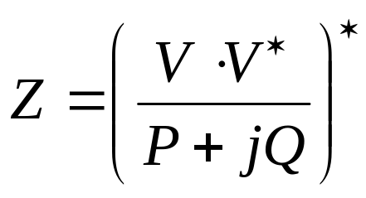
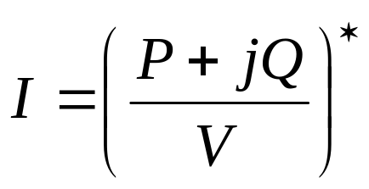
IEEE Load Format - Conversion
Convert constant impedance
Convert constant current
Be sure to use V as the appropriate phase voltage, not the base voltage, especially for constant current calculations!

Slide 39
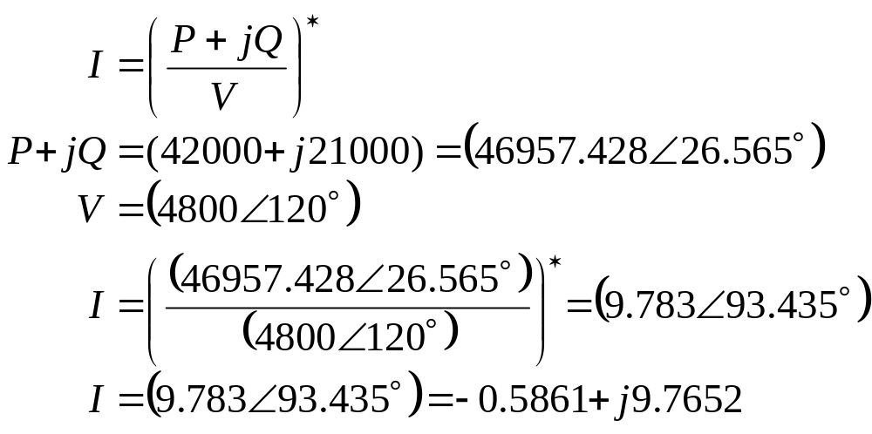
IEEE Load Format – Current Example
IEEE 37-node feeder node 741
  Delta connected
  Constant current
  42 kW and 21 kVAr on phase C

Slide 40
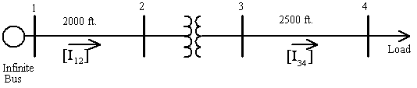
Feeder Example
IEEE 4 Node Feeder
It is looked at as a system of nodes and links
Use FBS and NR method to solve
  Compare the solutions

Slide 41
Powerflow Output
Three phase voltage at each node, including inherited objects
Power in and out and current in and out on each phase at each link, including inherited objects
Additional information available for specific objects, such as tap position or switch settings
Log of events (KML if specified)

Slide 42
Sample Powerflow Output
Load object: (node)
Transformer object: (link)
Name | constant_power_A | constant_power_B | constant_power_C | voltage_A | voltage_B | voltage_C
(load:11) (#11) | 1.8e+006+871780j W | 1.8e+006+871780j W | 1.8e+006+871780j W | 1918.94-271.698j V | -1266.24-1576.4j V | -697.555+1873.95j V
Name | configuration | status | from | to | power_in | power_out | phases
(transformer:8) (#8) | transformer_configuration:4 | CLOSED | node:7 | node:9 | +7.17672e+006 W | +6.81855e+006 W | ABCD

Slide 43
Newton-Raphson
Solves both radial system and meshed system
  Implementation:
    module powerflow {
      solver_method NR; //Newton Raphson – FBS is the default
    }
  Returns zero if there is no solution
  Returns positive number (iterations completed) if solved
  Returns negative number (# of iterations) when the solver could not converge
Syntax and outputs are the same between NR and FBS methods

Slide 44
Newton-Raphson
Two structures
  typedef struct {
  int type; // bus type (0=PQ, 1=PV, 2=SWING)
  complex *V[3]; // bus voltage
  complex *S[3]; // constant power
  complex *Y[3]; // constant admittance (impedance loads)
  complex *I[3]; // constant current
  double kv_base; // kV basis
  double mva_base; // MVA basis
  } BUSDATA;
  typedef struct {
  complex *Y[3][3]; // branch admittance
  int from; // index into bus data
  int to; // index into bus data
  double v_ratio; // voltage ratio(v_from/v_to)
  } BRANCHDATA;

Slide 45
Exercise 4.1
Load one IEEE 4-node test feeder, run it, and have a look at the output file.
Run the feeder with different transformer configurations and notice the effects.

Slide 46
Exercise 4.2
Load the IEEE 37-node test feeder, which will be used in other exercises.
There is a missing line. Find the missing line and fix the model to include the line.
Replace this line with a Delta-Delta transformer.
Connect an additional load via a node-to-node connection (e.g. without a link object).

Slide 47
Exercise 4.3
Load the IEEE 13-node test feeder, with building loads already attached.
Examine the interface between the powerflow module and the residential module at the triplex meter objects.

